Slide 1

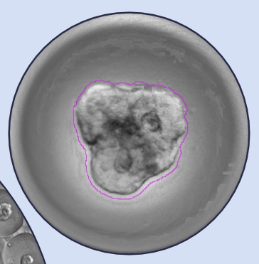

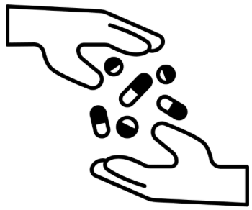
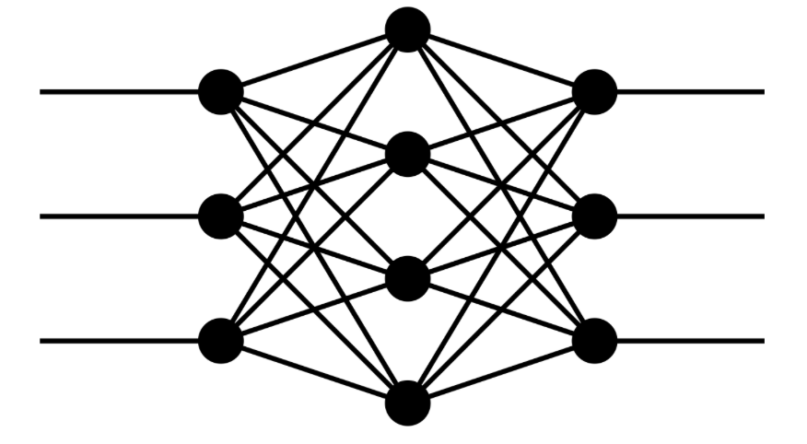
Deep Learning Project:
ATP Prediction from Organoid Time-Lapse Data

Slide 2





Organoids and ATP: A Functional Approach to Personalized Cancer Treatment
Patient with
CGR or PGR
Patient derivated organoids
Application of various treatments to the organoids
Large-scale time-lapse imaging of organoids over 96 hours
ATP assay used to assess drug response
Personnalized
drug

Slide 3
Introduction to Patients-Derived Organoids
« An organoid is a 3D miniaturized and simplified version of an organ grown in the lab from stem cells, which mimics key structural and functional features of the real organ. »
Organoids in Precision medicine :
Predict drug response and resistance
Reduce trial-and-error in treatment selection
Support the development of personalized therapies tailored to each patient’s biology

Slide 4
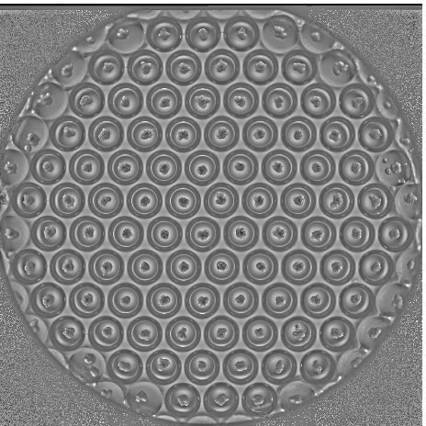
Dataset overview
Patient cohort
92 632 cavity videos (8 frames) from 1 199 wells
One well corresponds to a specific treatment at a given concentration for a particular patient
ATP (a measure of cellular energy production) is only available at the well level.
Number of patients | 51
CGR | 25
PGR | 26
Well
Cavity
Patient treatment tested at 3 concentrations
Low
Med
High
Ctrl
treatment
control

Slide 5
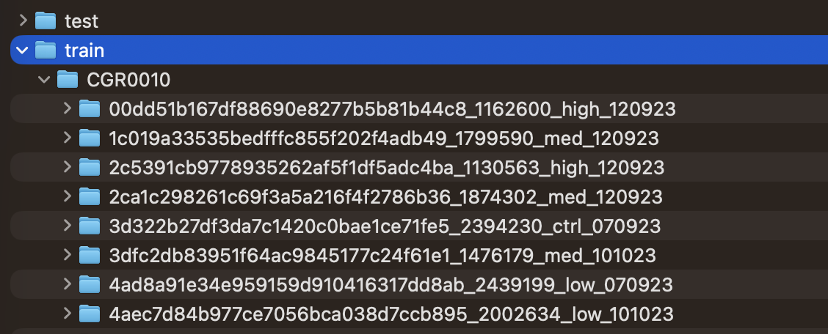
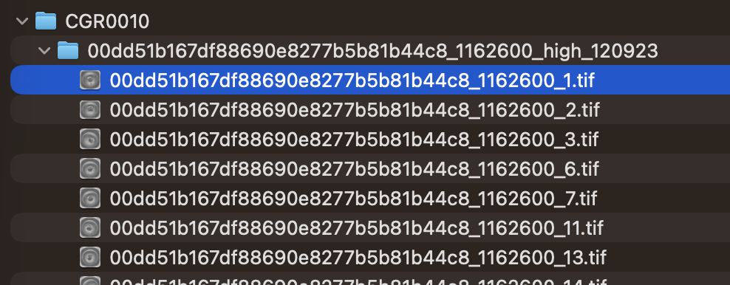
Dataset structure
Train set : 36 patients
Test set : 15 patients
concentration
7a683f90345118ecd3dc6788de7dfea6_125952_high_40325
Unique well ID
ATP
date

Slide 6
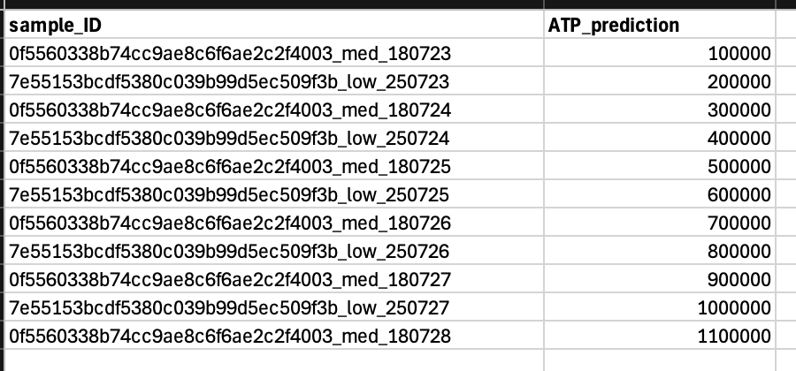

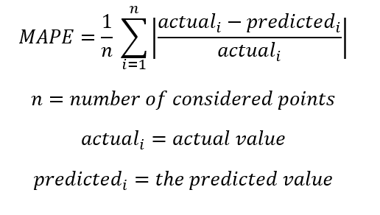
Pipeline for submission
Predictions submitted in the CSV file must be raw ATP values
Your model
submission file (.csv)
The ATP prediction will be evaluated using the Mean Absolute Percentage Error (MAPE).

